Slide 1
Working with different JavaScript frameworks and libraries
Different options to load JavaScript libraries

Slide 2
Agenda
Install JavaScript libraries
Configure JavaScript library bundling
Use the JavaScript libraries in a web part
Q&A

Slide 3
Install JavaScript libraries and type definitions
Install the npm packages for the libraries you need in your web part
Install the type definitions for the libraries
These commands install the type definitions into the node_modules@types folder.
Some libraries, such as Moment, provide their own type definitions, so you don't need to install them
> npm i jquery --save
> npm i jqueryui --save
> npm i chartist --save
> npm i moment --save
> npm i @types/jquery -D
> npm i @types/jqueryui -D
> npm i @types/chartist -D

Slide 4
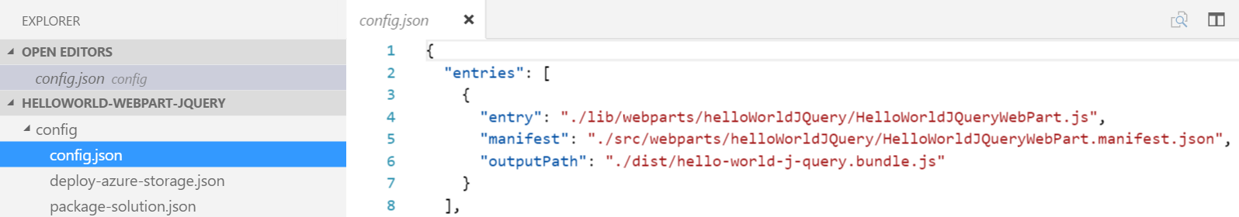
How dependencies are bundled
Any dependencies you add are bundled by default
You may exclude dependencies from the web part bundle
config.json configures the web part bundle
Entries region contains default bundle information
One entry exists for each web part in the solution
Notes:
By default, any dependencies you add are bundled into the web part bundle. In some cases, this is not ideal. You can choose to unbundle these dependencies from the web part bundle.
In Visual Studio Code, open the file config\config.json.
**Note: **This file contains information about your bundle(s) and any external dependencies.
The entries region contains the default bundle information. In this case, the jQuery web part bundle. When you add more web parts to your solution, you will see one entry per web part.
"entries": [ { "entry": "./lib/webparts/helloWorldJQuery/HelloWorldJQueryWebPart.js", "manifest": "./src/webparts/helloWorldJQuery/HelloWorldJQueryWebPart.manifest.json", "outputPath": "./dist/hello-world-j-query.bundle.js" } ]
The externals section contains the libraries that are not bundled with the default bundle.
"externals": {}
Exclude jQuery from the default bundle, by adding the jQuery module to the externals section.
"jquery":"node_modules/jquery/dist/jquery.min.js"

Slide 5
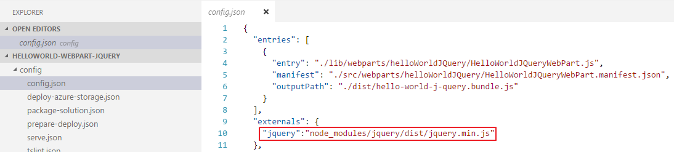
Excluding dependencies from the default web part bundle
The externals section contains the libraries that are not bundled with the default bundle
To exclude a dependency, add it to the externals section

Slide 6
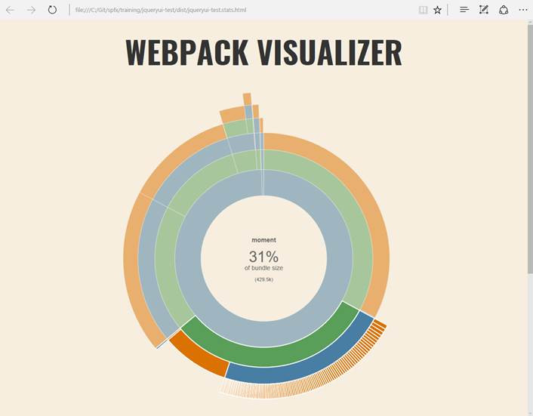
Bundling impact
Avoid bundling when not needed
Some libraries are enormous
Example: moment.js used in lab exercise - 429.5k (per web part) added to the bundle
Use the WebPack visualizer to inspect the web part bundle

Slide 7
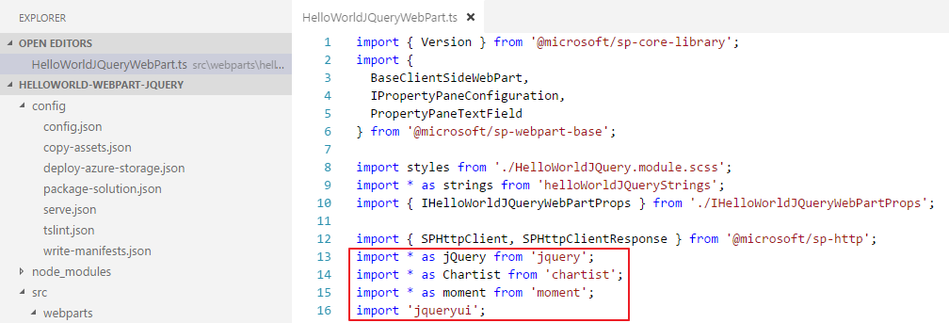
Import libraries into a web part
Use import statements in the web part class

Slide 8
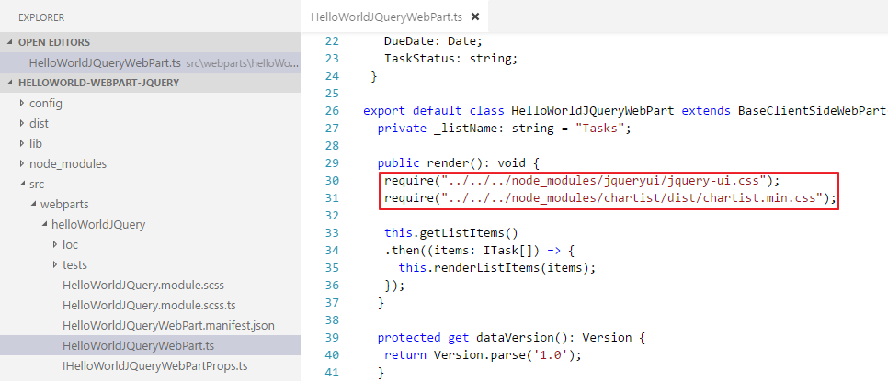
Load CSS used by library components
Use require statements in the web part class

Slide 9
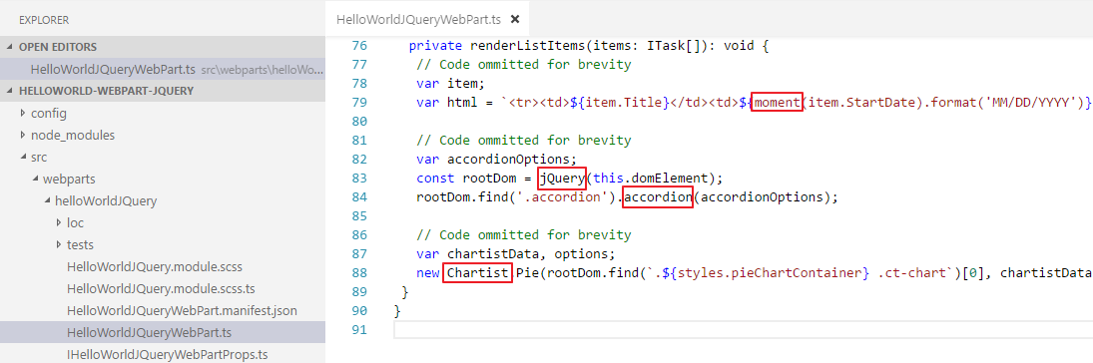
Use the libraries in the web part class
Use require statements in the web part class
Use the libraries

Slide 10
DEMO
Different options to load JavaScript libraries
Notes:
Use Exercise 3: Use different JavaScript libraries (jQuery, Chartist, Moment) in a SPFx client-side web part in the lab manual.

Slide 11
Summary
Install JavaScript libraries
Configure JavaScript library bundling
Use the JavaScript libraries in a web part
Q&A

Slide 12

Sharing is caring…
Code samples and solutions
Reusable components
Guidance documentation
Monthly community calls
SharePoint Framework
SharePoint add-ins
Microsoft Graph
Office 365 APIs
http://aka.ms/SharePointPnP

Slide 13

Q&A

Slide 14


